Slide 1
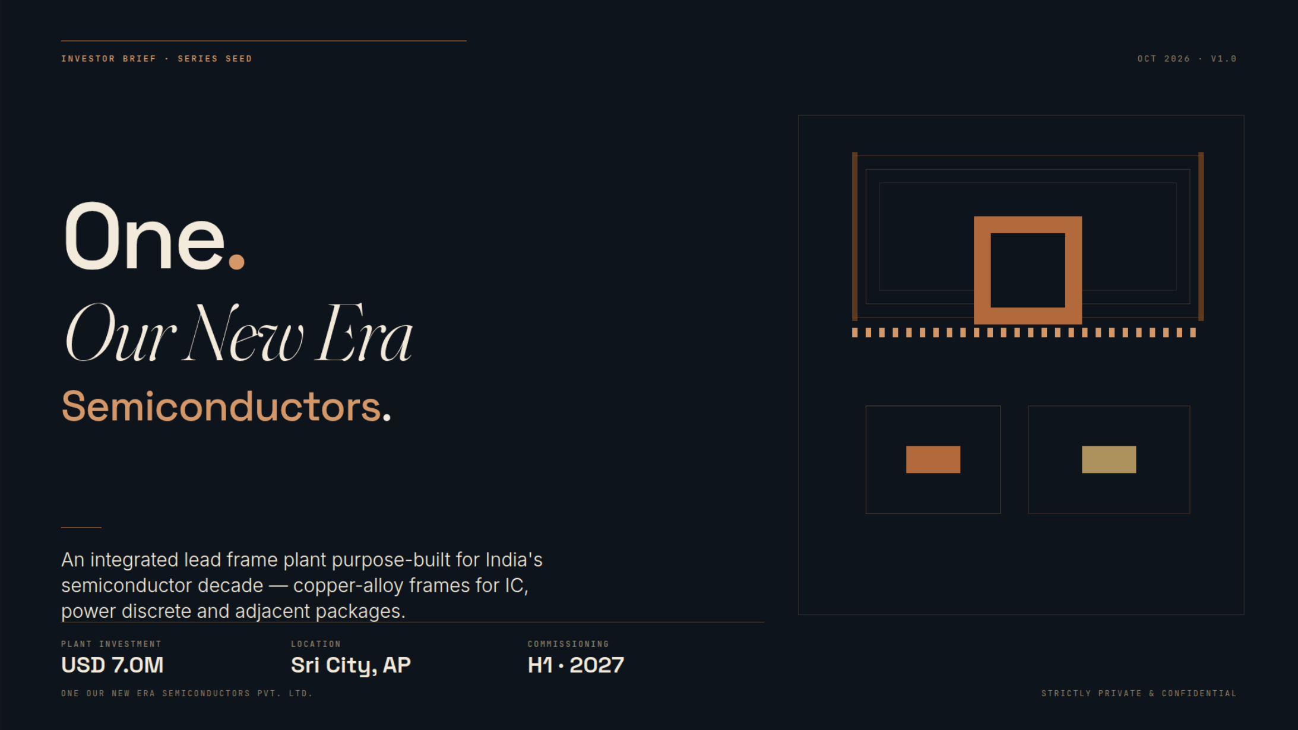
1

Slide 2

2

Slide 3
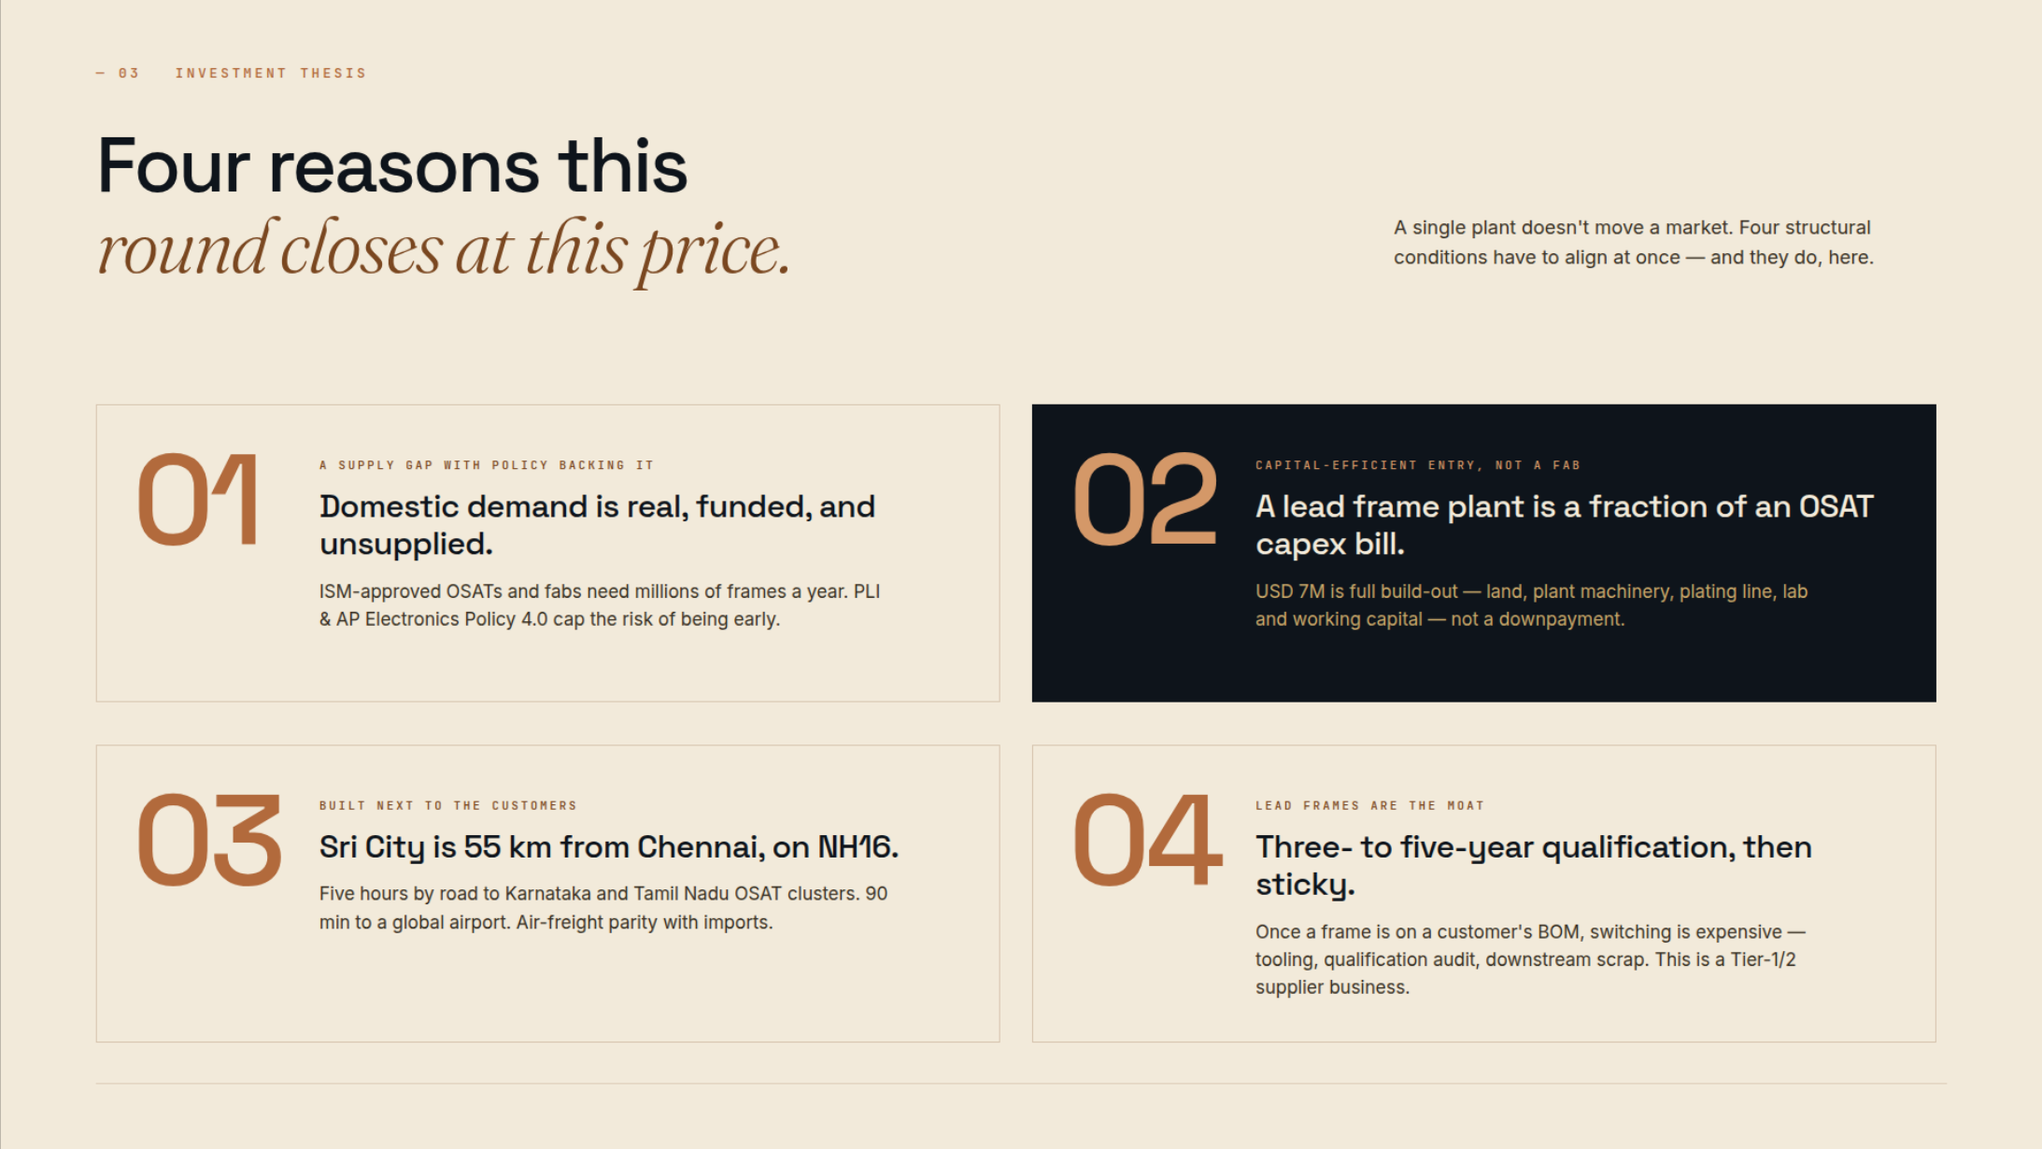
3

Slide 4
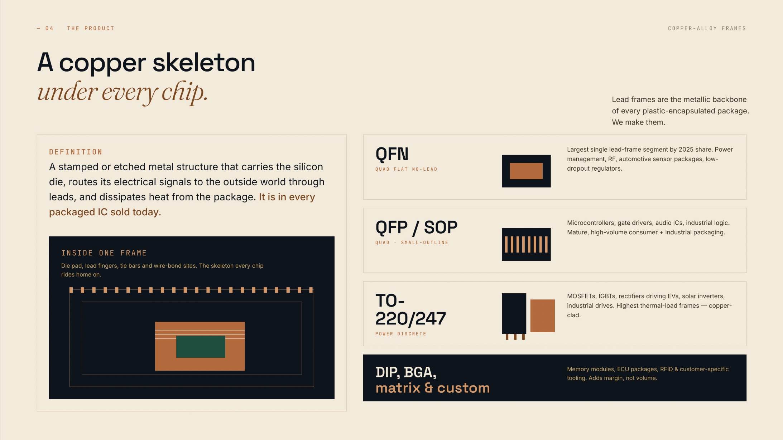
4

Slide 5
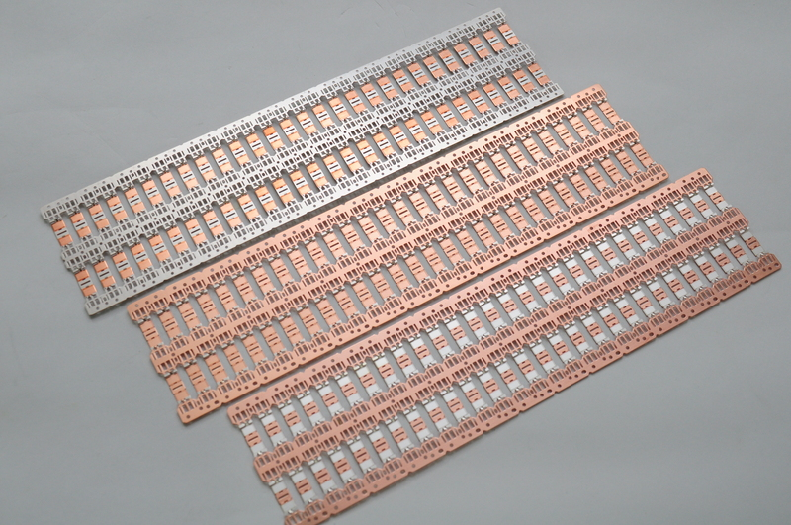
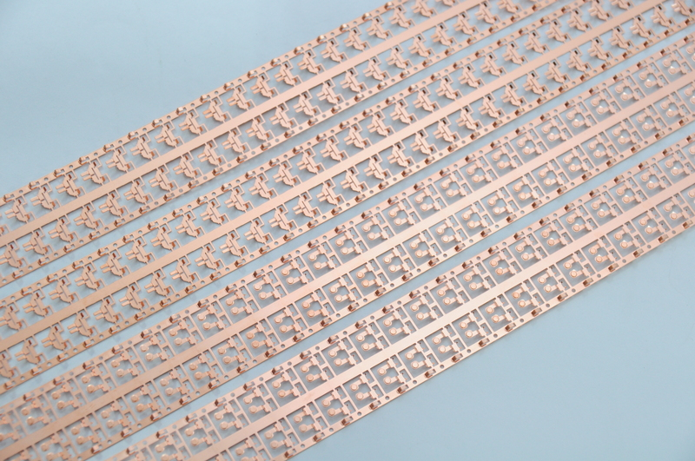
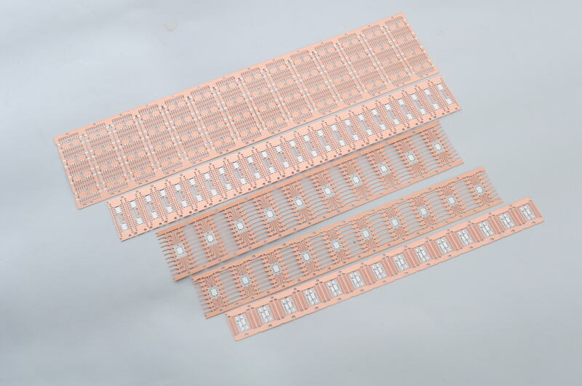
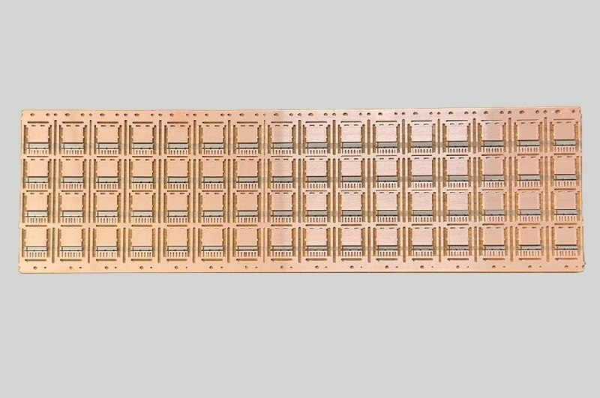
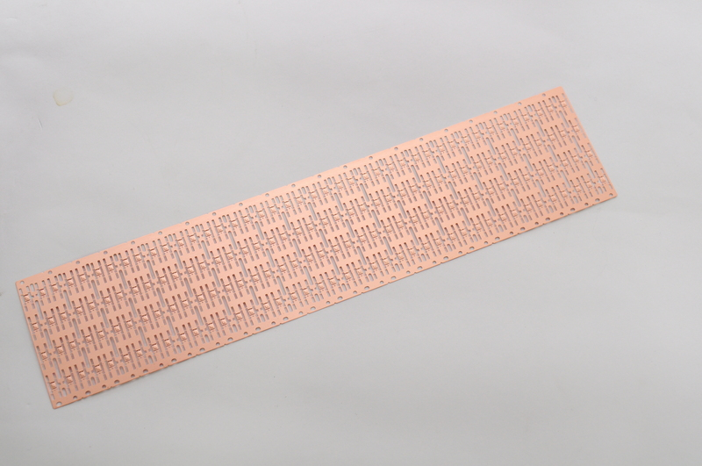
PRODUCT GALLERY
Lead frame portfolio
01 IC Lead Frame
02 High Power Discrete Lead Frame
03 Power Discrete Lead Frame
04 High Precision IC Lead Frame
05 Mount Device Lead Frame
5

Slide 6
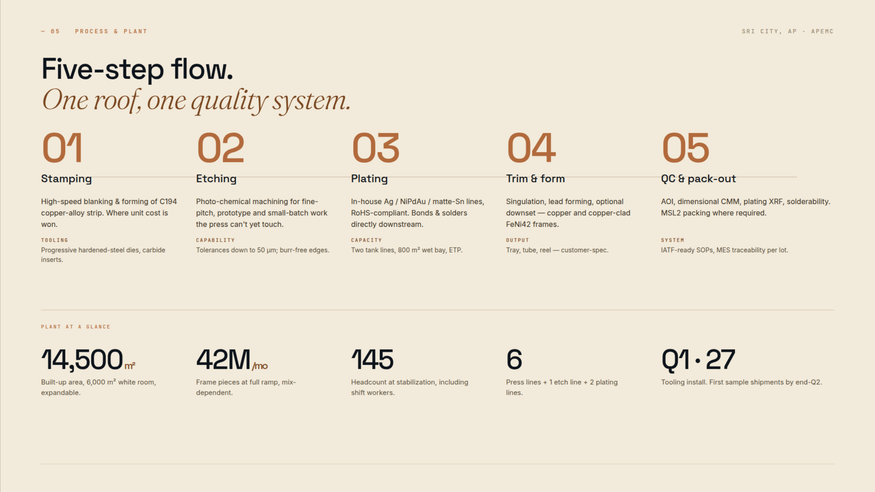
20.83M/mo
REVISED MODEL: 250M units/year = 20.83M/month at full capacity; Year 5 revenue $13.40M. Earlier targets superseded.
6

Slide 7
MANUFACTURING PROCESSES
Two routes to a finished lead frame.
01 Pre-plating Processes
02 Post-plating Processes
Plate first, then stamp.
Stamp first, then plate.
01
02
03
01
02
03
Copper Alloy Strip
→
Stripe Plating
→
Stamping
42 Alloy, Cu Material
→
Stamping
→
Spot Plating
↓
↓
06
05
04
06
05
04
Shipping
←
Inspection & Packing
←
Cleaning
Shipping
←
Inspection & Packing
←
Cutting
Stamping output: frame or reel. Cleaning and packing follow the required delivery format.
Cutting produces individual frames. Inspection, protective packing and shipping complete the route.
Process sequence reproduced from the supplied reference image.
7

Slide 8
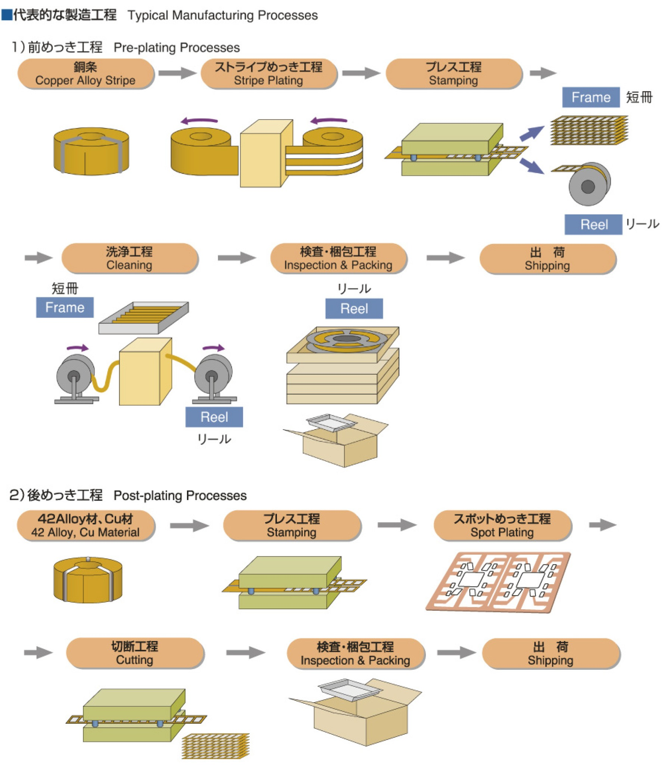
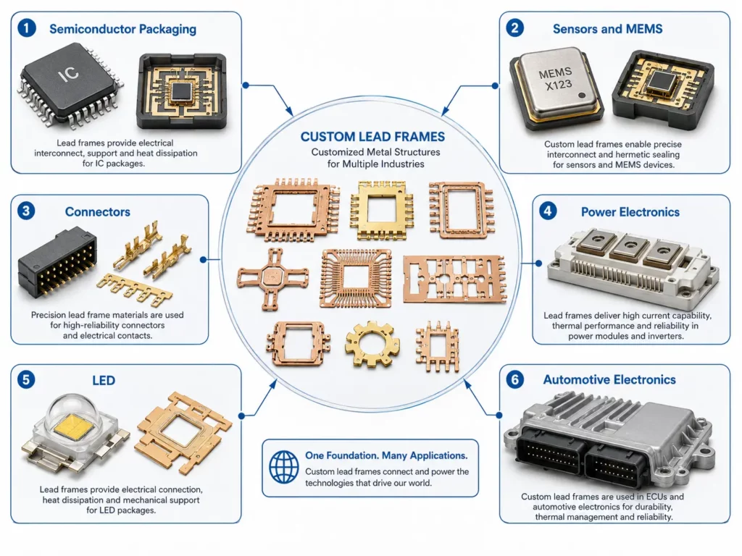
Typical Manufacturing Processes
8

Slide 9
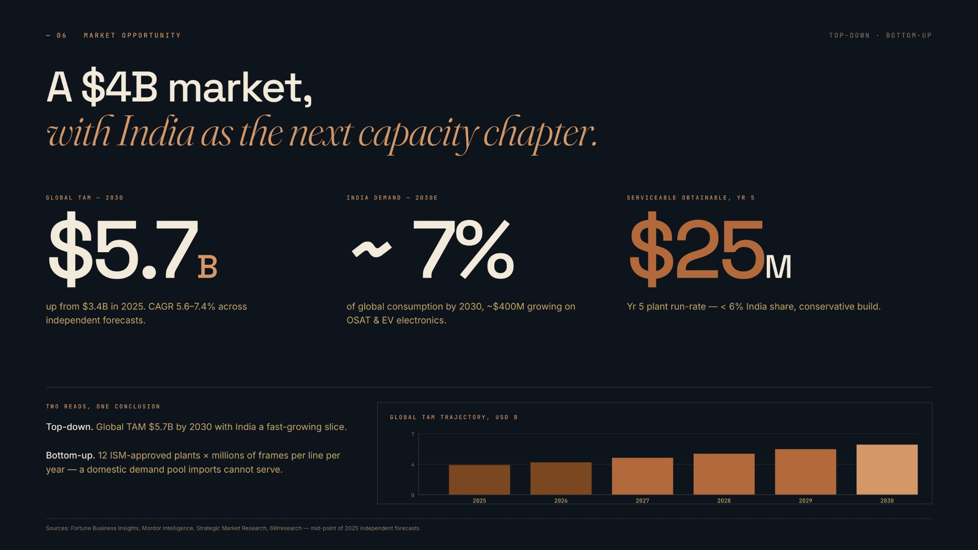
$13.4M
REVISED MODEL: 250M units/year = 20.83M/month at full capacity; Year 5 revenue $13.40M. Earlier targets superseded.
9

Slide 10
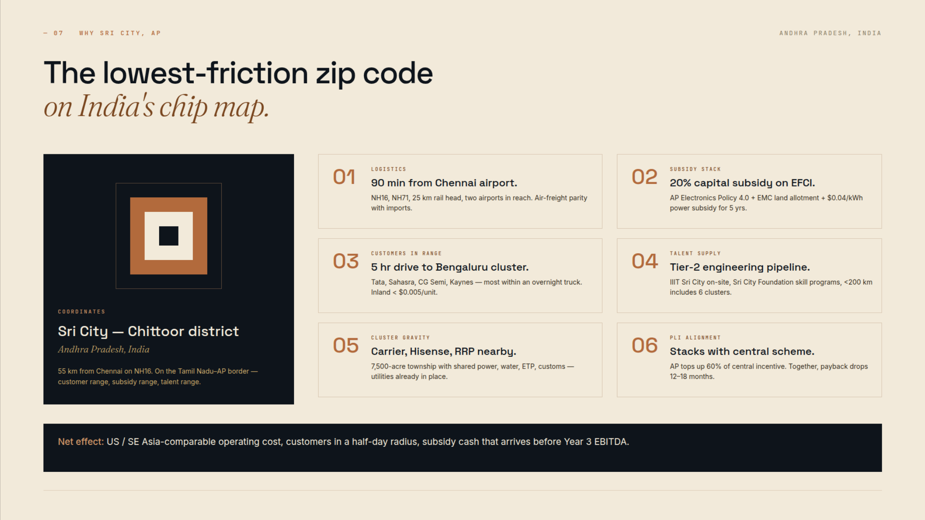
Sri City — Tirupathi District
10

Slide 11
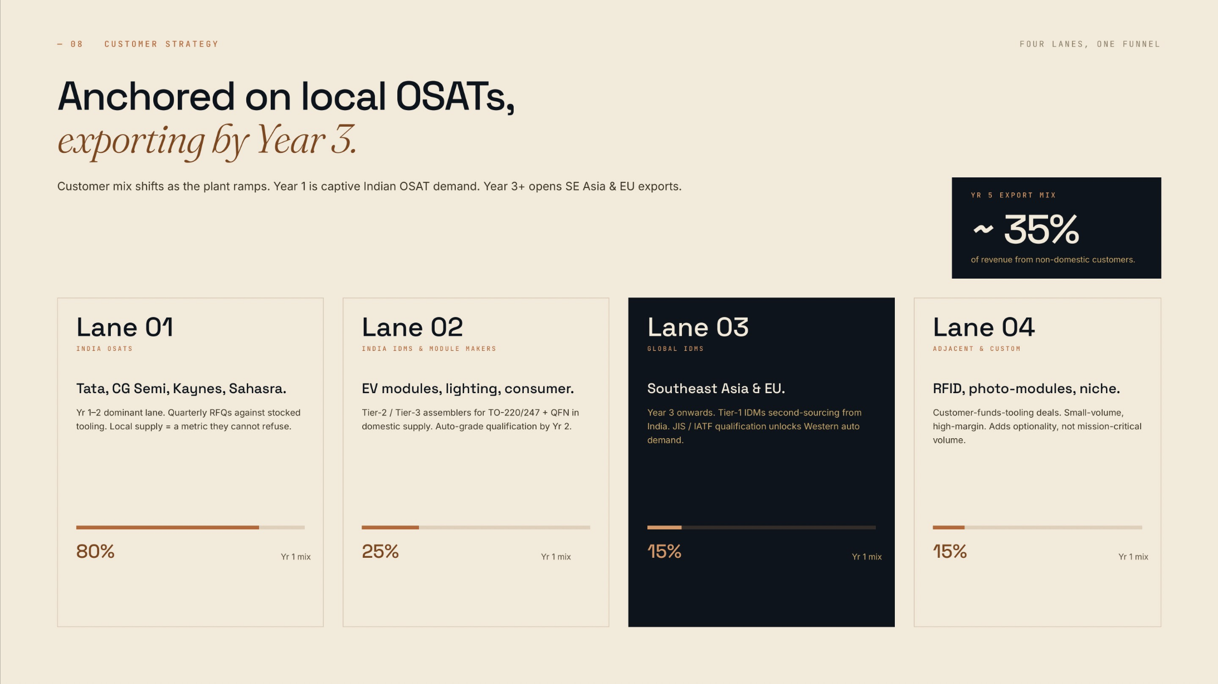
11

Slide 12
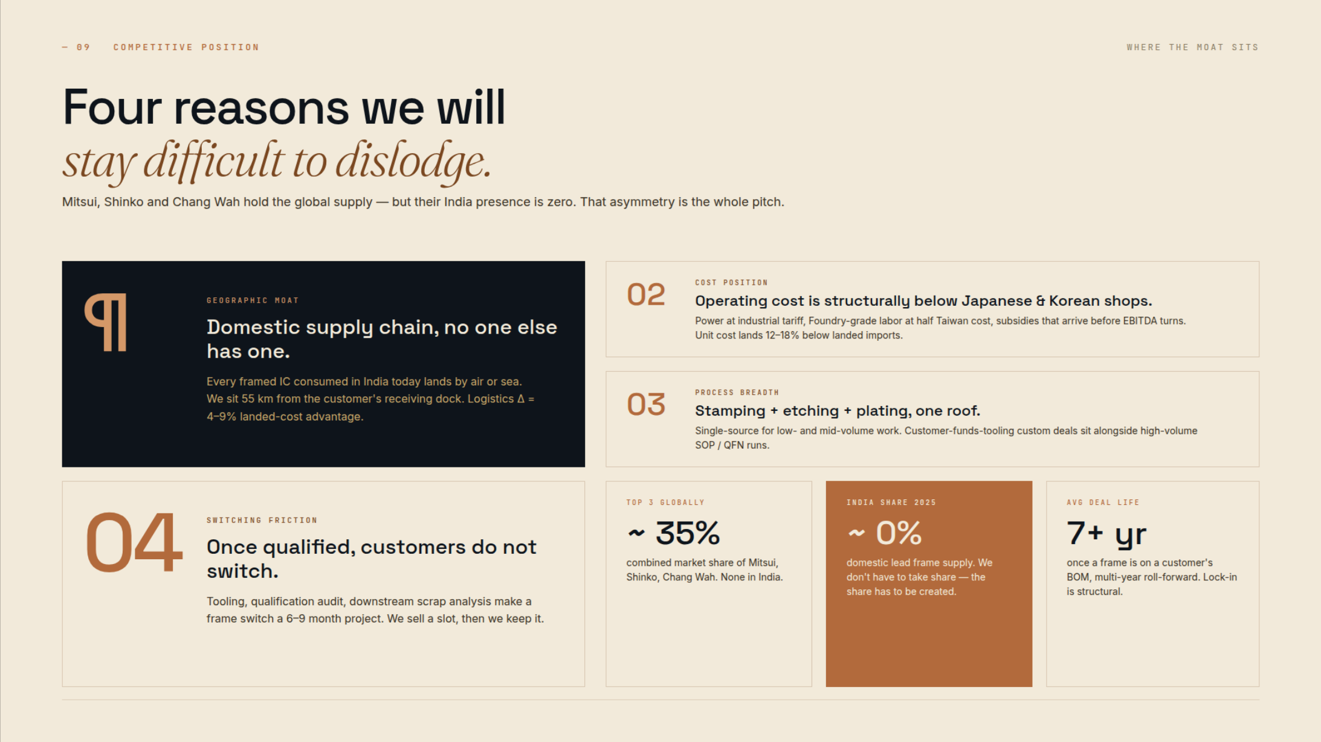
12

Slide 13
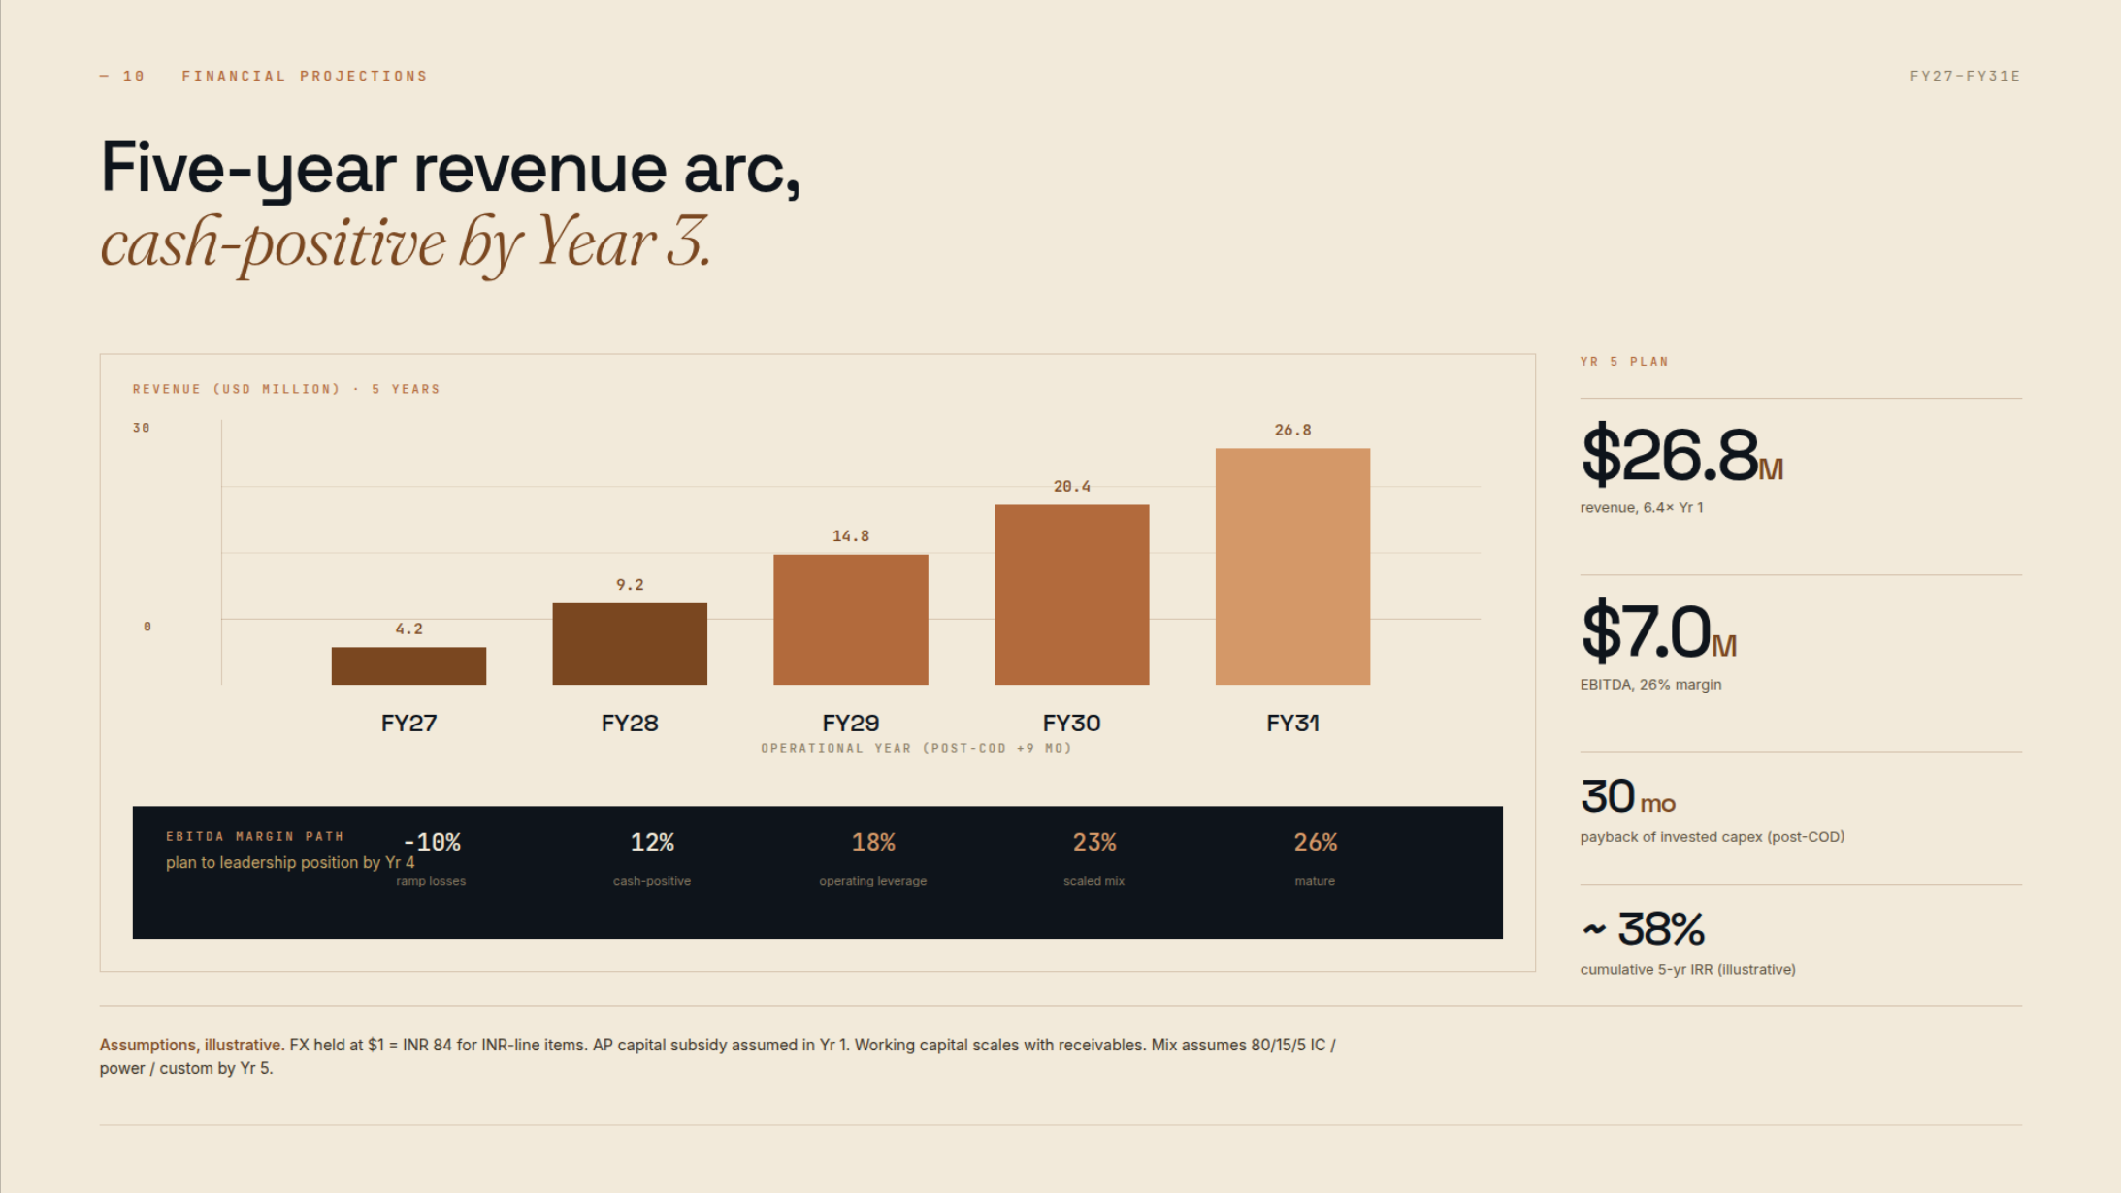
— 10 FINANCIAL PROJECTIONS
A defined utilisation ramp,
at 250 million units per year.
USD million / volume | FY27 | FY28 | FY29 | FY30 | FY31
Plant utilisation | 75% | 85% | 95% | 100% | 100%
Sales volume (million units) | 187.50 | 212.50 | 237.50 | 250.00 | 250.00
Revenue | 10.05 | 11.39 | 12.73 | 13.40 | 13.40
EBITDA | 1.27 | 1.94 | 2.61 | 2.95 | 2.95
EBITDA margin | 12.7% | 17.1% | 20.5% | 22.0% | 22.0%
Profit after tax — debt scenario | 0.58 | 0.93 | 1.47 | 1.76 | 1.80
Illustrative model: 250M units/year; constant average price $0.0536/unit; variable cash costs 50% of revenue; fixed cash costs $3.752M/year. Depreciation $0.50M/year, tax 25% of positive PBT. Debt scenario detailed on slide 16. Subsidy receipts excluded. This 250M-unit model supersedes earlier capacity, revenue, return and payback targets.
13

Slide 14
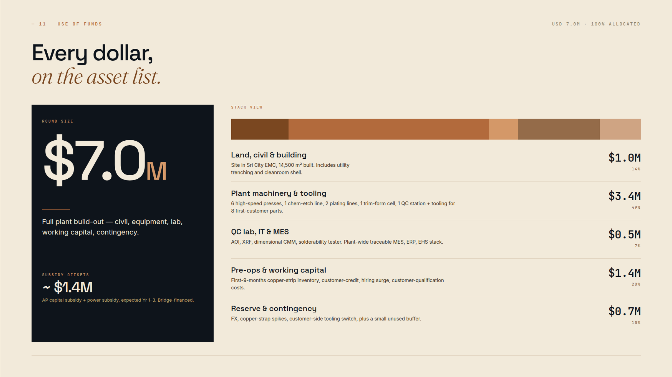
FISCAL SUPPORT FROM GOVERNMENT OF INDIA:
30% or $2.1 M
of Capital Expenditure on pari-passu basis or upto $ 2.1 Million
14

Slide 15
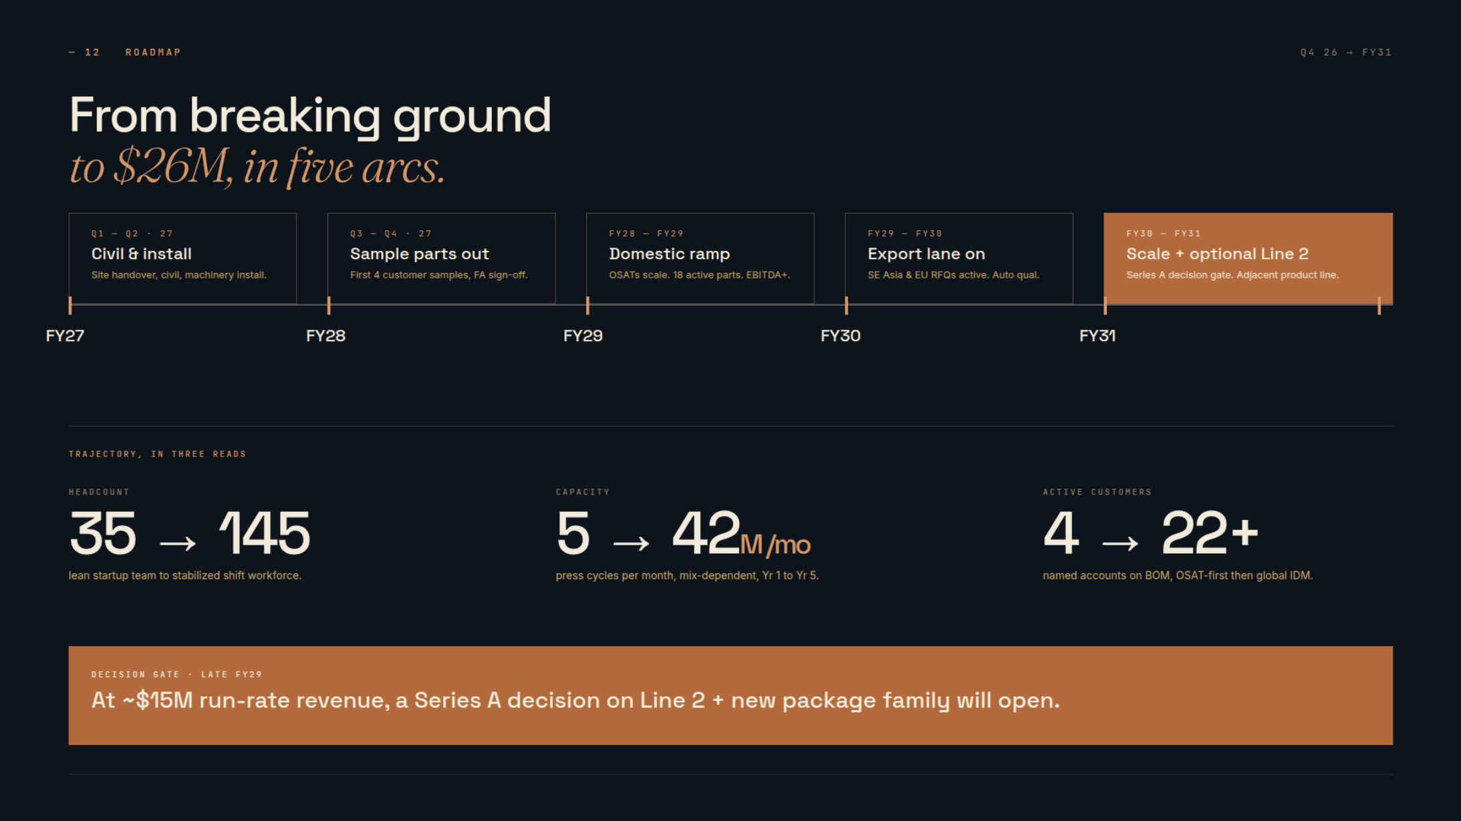
to $13.4M, in five arcs.
5 → 20.83M/mo
At full-capacity revenue of $13.4M, review Line 2 expansion against customer demand and cash generation.
REVISED MODEL: 250M units/year = 20.83M/month at full capacity; Year 5 revenue $13.40M. Earlier targets superseded.
15

Slide 16
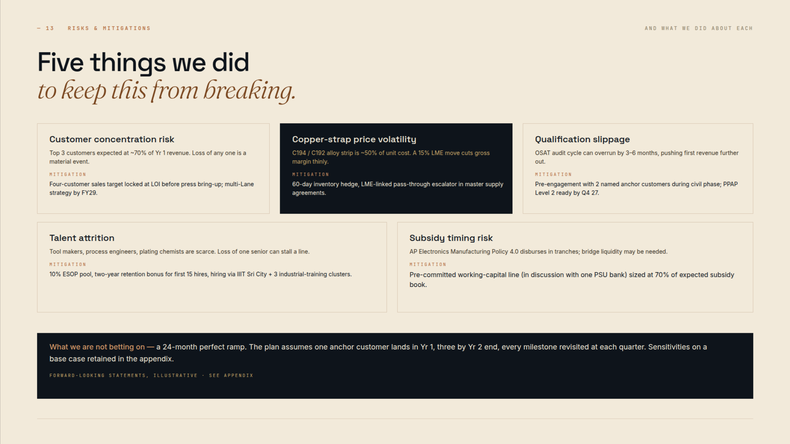
16

Slide 17
— 15 PROJECTED PROFIT & LOSS
ILLUSTRATIVE • USD MILLION
Five years of operating growth,
at the requested utilisation levels.
USD million | FY27 | FY28 | FY29 | FY30 | FY31
Plant utilisation | 75% | 85% | 95% | 100% | 100%
Revenue | 10.05 | 11.39 | 12.73 | 13.40 | 13.40
Operating costs (before D&A) | 8.78 | 9.45 | 10.12 | 10.45 | 10.45
EBITDA | 1.27 | 1.94 | 2.61 | 2.95 | 2.95
EBITDA margin | 12.7% | 17.1% | 20.5% | 22.0% | 22.0%
Depreciation | 0.50 | 0.50 | 0.50 | 0.50 | 0.50
EBIT | 0.77 | 1.44 | 2.11 | 2.45 | 2.45
Interest — debt scenario | 0.00 | 0.20 | 0.15 | 0.10 | 0.05
Profit before tax | 0.77 | 1.24 | 1.96 | 2.35 | 2.40
Tax | 0.19 | 0.31 | 0.49 | 0.59 | 0.60
Profit after tax | 0.58 | 0.93 | 1.47 | 1.76 | 1.80
250M units/year × utilisation × $0.0536/unit. Variable costs: 50% of sales; annual fixed cash costs: $3.752M. Assumptions: $0.50M annual straight-line depreciation; tax at 25% of positive PBT, with no loss carry-forward benefit. Interest follows the separate scenario on slide 16. Figures rounded.
17

Slide 18
— 16 CASH FLOW & DEBT COVERAGE
ILLUSTRATIVE • USD MILLION
Cash flow follows the ramp,
after working capital and maintenance.
USD million / ratio | FY27 | FY28 | FY29 | FY30 | FY31
EBITDA | 1.27 | 1.94 | 2.61 | 2.95 | 2.95
Cash tax | 0.19 | 0.31 | 0.49 | 0.59 | 0.60
Increase in working capital | 0.11 | 0.20 | 0.20 | 0.10 | 0.00
Maintenance capital expenditure | 0.10 | 0.10 | 0.10 | 0.10 | 0.10
Cash available for debt service | 0.87 | 1.33 | 1.82 | 2.16 | 2.25
Interest + principal | 0.00 | 0.70 | 0.65 | 0.60 | 0.55
DSCR | N/A | 1.90x | 2.80x | 3.60x | 4.09x
Cash after debt service | 0.87 | 0.63 | 1.17 | 1.56 | 1.70
Closing scenario debt | 0.00 | 1.50 | 1.00 | 0.50 | 0.00
Illustrative additional debt only: $2.00M drawn at FY28 start, 10% annual interest on opening balance, $0.50M principal repaid at each year-end FY28–31. Original $7M equity ask retained. Working capital: 15% of sales, minimum $1.40M funded at COD. Subsidies excluded. DSCR = CFADS ÷ (interest + principal).
18

Slide 19
— 17 BREAK-EVEN
ILLUSTRATIVE • USD MILLION
A clear operating threshold,
with room for the ramp.
USD million / ratio | FY27 | FY28 | FY29 | FY30 | FY31
Planned revenue | 10.05 | 11.39 | 12.73 | 13.40 | 13.40
Implied fixed operating costs | 3.75 | 3.75 | 3.75 | 3.75 | 3.75
EBITDA break-even revenue | 7.50 | 7.50 | 7.50 | 7.50 | 7.50
EBIT break-even revenue | 8.50 | 8.50 | 8.50 | 8.50 | 8.50
Revenue above EBITDA break-even | 2.55 | 3.89 | 5.23 | 5.90 | 5.90
EBITDA break-even utilisation | 56.0% | 56.0% | 56.0% | 56.0% | 56.0%
EBITDA margin of safety | 25.3% | 34.1% | 41.1% | 44.0% | 44.0%
FY31 EBITDA BREAK-EVEN $7.50M | 56% of planned FY31 revenue
Assumed variable operating costs = 50% of revenue; contribution margin = 50%. Fixed costs held at $3.752M/year, calibrated to prior FY31 EBITDA; not a vendor cost estimate. EBITDA break-even = fixed costs ÷ 50%; EBIT break-even adds depreciation. Margin of safety = (sales − break-even sales) ÷ sales.
19

Slide 20
— 18 DOWNSIDE SENSITIVITY
ILLUSTRATIVE • USD MILLION
Stress the first repayment year,
before relying on later scale.
FY28 scenario | Revenue | EBITDA | CFADS | DSCR
Base case | 11.39 | 1.94 | 1.33 | 1.90x
Volume −20% | 9.11 | 0.80 | 0.79 | 1.12x
Selling price −10% | 10.25 | 0.80 | 0.65 | 0.93x
Variable unit cost +10% | 11.39 | 1.37 | 0.90 | 1.29x
Combined downside | 8.20 | (0.56) | (0.56) | -0.79x
FY28 base-case DSCR is 1.90x under the revised assumptions.
Downside cases weaken debt coverage; combined downside DSCR remains below 1.0x.
One-variable stresses keep other assumptions constant. Volume changes variable costs; price changes do not. Fixed costs held at FY28 base level. Working-capital target is 15% of sales, minimum $1.40M; downside releases working capital versus FY27. Debt service remains $0.70M. Annual model excludes monthly liquidity, receivable delays, subsidy proceeds and initial equity/capex flows.
20

Slide 21
VIDEO
Lead frame video
Open video on YouTube
21

Slide 22
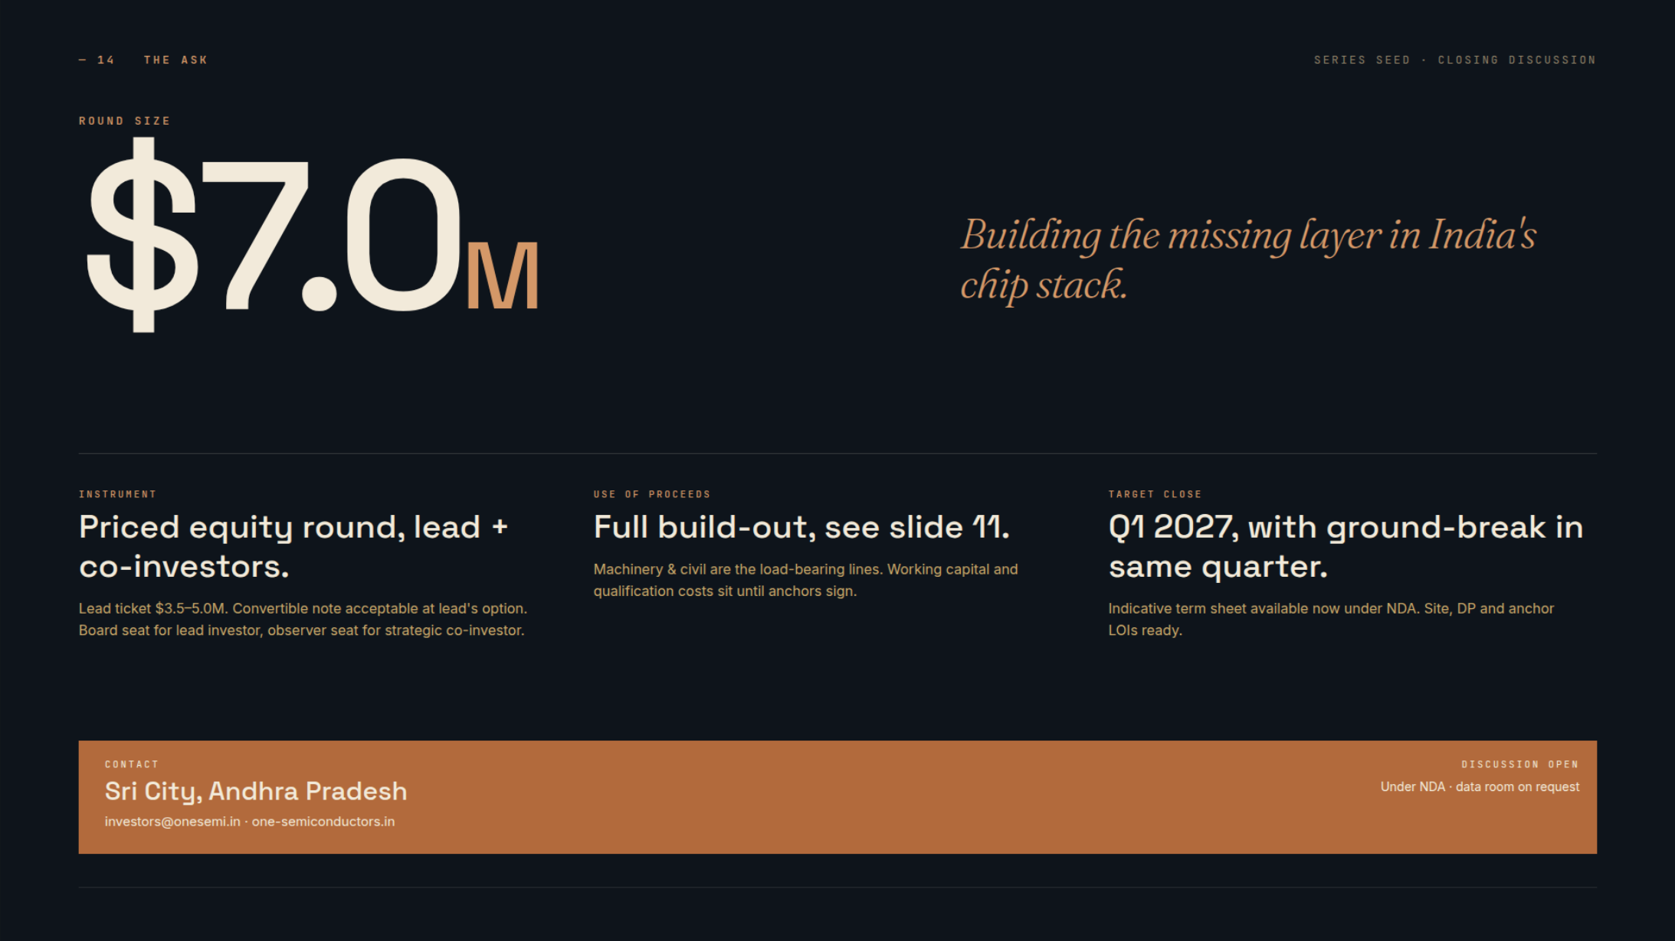
CONTACT
SLN Terminus Building, Gachibowli, Hyderabad, Telangana, India
investors@weareone.asia
www.weareone.asia
22

